Slide 1
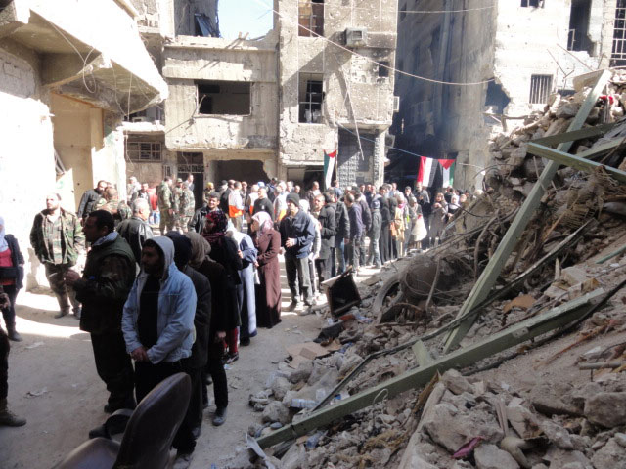
Learning Activity 2.1.3
Scenario
You are a humanitarian worker. A city is under siege. How can the mission help with the challenges?
UN Core Pre-Deployment Training Materials 2017

